Slide 1


Problem Statement & Motivation
Stress Detection
Emotion Recognition
Stress-related disorders are among the leading causes of global disability. Traditional self-report methods lack real-time, objective monitoring capability.
Existing facial/speech-based emotion systems fail in controlled or privacy-sensitive settings. Physiological signals offer a more objective alternative.
🎯 Goal: Develop accurate, interpretable & deployable AI systems for real-world clinical healthcare scenarios

Slide 2
Literature Survey & Research Gaps
Existing Work
Identified Research Gaps
Stress Detection: SVM/KNN on WESAD dataset — moderate accuracy; nonlinear signal challenges Emotion Recognition: Facial & speech methods — affected by environment, privacy concerns, high compute needs
1. Limited integration of domain knowledge & explainability in embryo AI
2. Stress models tested only in lab settings — poor real-world generalizability
3. Few low-cost, real-time embedded emotion recognition implementations
4. Lack of continuous psychological dimensions (valence, arousal) in classification
5. No unified framework combining interpretability, hardware & software deployment
This thesis addresses all three gaps through interpretable AI + physiological signals + embedded hardware

Slide 3
Thesis Overview – Integrated Frameworks
01
02
MindWatch: Stress
Detection
Real-Time Emotion
Recognition
Multimodal Wearable Signals
(EDA, BVP, HR, TEMP)
XGBoost + SHAP
→
Raspberry Pi + Multi-Sensor
Random Forest Classifier
+ Recommendation System
97% Acc | ROC-AUC 0.99
97% Acc | ROC-AUC 0.965

Slide 4
MindWatch: Wearable Stress Detection
Dataset & Signals (WESAD)
ML Pipeline
EDA – Electrodermal Activity (skin conductance)
BVP – Blood Volume Pulse
HR – Heart Rate
IBI – Inter-Beat Interval
TEMP – Skin Temperature
ACC – 3-Axis Accelerometer (X, Y, Z)
1
Preprocessing LPF filtering (BVP fc=0.5Hz, EDA fc=1Hz)
Z-score normalization per subject
2
Feature Extraction EDA peaks, RMSSD, SDNN, BVP entropy,
HR stats, ACC signal vector magnitude
3
Class Balancing SMOTE synthetic oversampling
for minority (stress) class
15 participants | 3 conditions: Baseline, Stress, Amusement 70+ features extracted per 60s window SMOTE used for class balancing
4
Model Training Random Forest, SVM (RBF), XGBoost
5-fold stratified cross-validation
5
Interpretability SHAP values — EDA, HR, RMSSD
identified as top stress markers

Slide 5
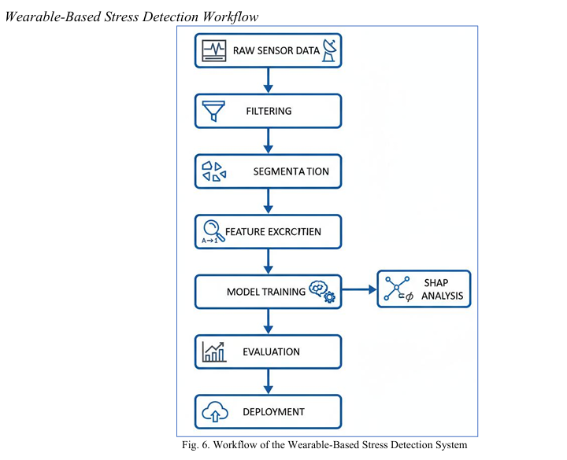
MindWatch: System Architecture

Slide 6
MindWatch: Results & Performance
97%
0.99
96%
0.985
XGBoost Accuracy
ROC-AUC
Random Forest Acc
RF ROC-AUC
Model Comparison
Model | Accuracy | Precision | Recall | ROC-AUC
XGBoost ★ | 0.97 | 0.97 | 0.95 | 0.996
Random Forest | 0.96 | 0.96 | 0.98 | 0.985
MLP Neural Net | 0.96 | 0.97 | 0.96 | 0.98
Naïve Bayes | 0.67 | 0.50 | 0.76 | 0.712
Logistic Regression | 0.66 | 0.46 | 0.27 | 0.611

Slide 7
Real-Time Emotion Recognition: Hardware & System
Raspberry Pi Hardware Stack
System Workflow
MAX30102 Heart Rate (HR) Protocol: I²C
1
8-second continuous physiological scan
2
HR smoothing + ACC normalization + HRV derivation
GSR + ADS1115 Electrodermal Activity (EDA) Protocol: I²C
3
Feature vector: [HR, HRV, EDA, TEMP, ACCx, ACCy, ACCz]
ADXL345 3-Axis Acceleration (X,Y,Z) Protocol: I²C
4
Random Forest → Emotion class (Calm / Happy / Stress / Sad / Fear)
DS18B20 Body Temperature Protocol: 1-Wire
5
Emotional Index (Valence, Arousal, Engagement)
6
Personalized recommendations (relaxation, activity, etc.)

Slide 8
Emotion Recognition: System Architecture

Slide 9
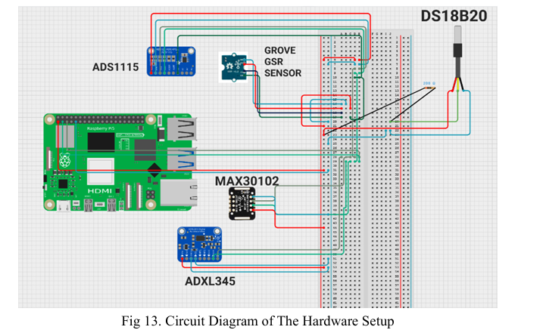
Emotion Recognition: Hardware Design

Slide 10
Emotion Recognition: Results
97%
0.965
0.98
5
RF Accuracy
ROC-AUC
Precision
Emotion Classes
Per-Class Classification Performance (Confusion Matrix Summary)
Emotion | Correct | Total | Misclassified As
Calm | 79/80 | 80 | 1 → Happy
Fear | 78/80 | 80 | 2 → Stress
Happy | 76/80 | 80 | 4 → Neutral
Neutral | 77/80 | 80 | 3 → Happy
Stress ★ | 80/80 | 80 | None — Perfect!

Slide 11
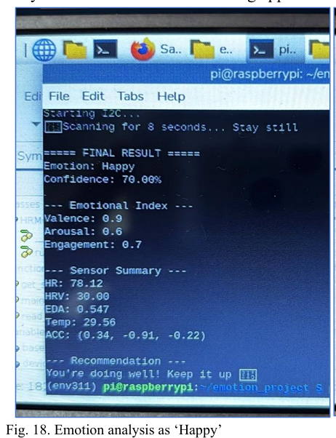
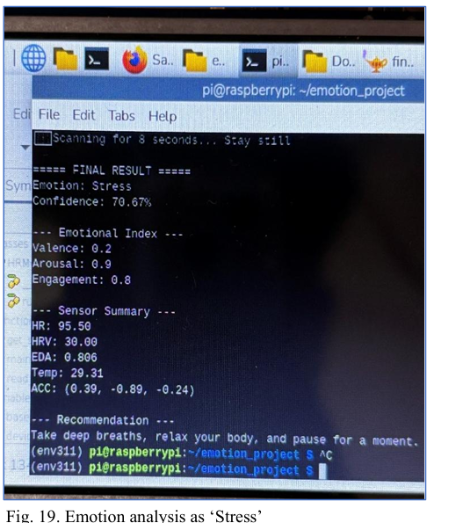
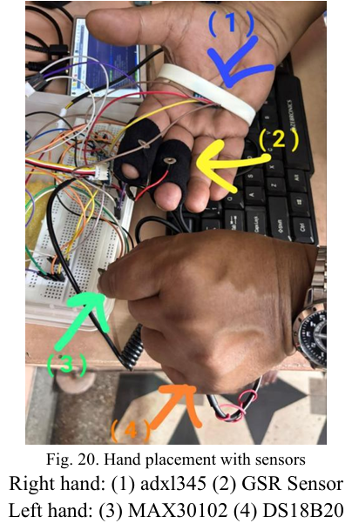
Emotion Recognition: Results

Slide 12
Explainability & Interpretability (XAI)
SHAP Analysis
Probability
Confidence Score
Project: MindWatch Stress Detection
Project: Emotion Recognition
SHapley Additive exPlanations assign a fair contribution score to each physiological feature. EDA, HR, and RMSSD emerged as the top contributors to stress detection — consistent with autonomic nervous system physiology literature.
The Random Forest ensemble outputs a probability for each emotion class via majority voting across decision trees. Emotional index dimensions (Valence, Arousal, Engagement) provide a richer psychological picture beyond discrete labels.
→ Feature transparency supports clinician confidence & model debugging
→ Actionable recommendations are generated from the predicted state

Slide 13
Publications & Conferences
Knowledge-Guided Nested Deep Learning Framework for Explainable Embryo Viability Assessment in ARTs
Published
1
2025 IEEE Silchar Subsection Conference (SILICON)
DOI: 10.1109/SILICON67893.2025.11327048
MindWatch: Next-Generation Wearable Framework for Stress Monitoring and Prediction
Published
2
2025 13th IEEE International Conference on Intelligent Embedded Systems (IEMECON)
DOI: 10.1109/IEMECON69302.2025.1136581
Smart Emotional Wellness Analysis Utilizing Multi-Sensor Biological Information
In Preparation
3
To be submitted to IEEE CIACON 2026
Manuscript in preparation

Slide 14
CONCLUSION
This thesis looked into how artificial intelligence can help solve major challenges in healthcare using three connected systems: embryo quality assessment, stress detection, and real-time emotion recognition. Each framework aimed to tackle real issues like data imbalance, noise in physiological signals, and the need for clear outcomes. The results show that AI methods, along with domain knowledge and proper data processing techniques, can offer reliable and meaningful solutions for practical healthcare uses.

Slide 15
Future Scope & Roadmap
MindWatch
Emotion System
Deploy on wearable & mobile devices for continuous monitoring
Extend to real-world naturalistic settings (beyond lab)
Add deep learning (LSTM) for temporal stress patterns
Add more physiological modalities & contextual data
Build personalized user models for individual differences
Integrate all 3 frameworks into unified health monitoring platform
Vision: Unify all three frameworks into a single intelligent, interpretable, real-time Smart Healthcare Platform

Slide 16
REFERENCES
R. M. Rad, P. Saeedi, J. Au, and J. Havelock, “Predicting human embryos’ implantation outcome from a single blastocyst image,” in Proc. 41st Annu. Int. Conf. IEEE Eng. Med. Biol. Soc. (EMBC), Berlin, Germany, Jul. 2019, pp. 920–924.
Ritu Jain and Gaurav Mehta. An ensemble-based framework for stress detection using wearable sensor data. Journal of Ambient Intelligence and Humanized Computing, 14(2):1675–1690, 2023.
Koelstra, S. et al., “DEAP: A Database for Emotion Analysis Using Physiological Signals”, IEEE, 2012.
Healey, J., “Wearable and Automotive Systems for Affect Recognition”, MIT, 2000.
T. Baczkowski, R. Kurzawa and W. Glabowski, “Methods of embryo scoring in in vitro fertilization,” Reproductive biology, vol. 4, no. 1, pp. 5–22, 2004.

